Slide 1



W2D5 – CRUD with Express

Slide 2

Agenda
RECAP - ARCHITECTURE
CRUD
HTTP VERBS
EXPRESS

Slide 3

ARCHITECTURE
3-Tier, N-Tier
Notes:
What are callbacks? Anyone remember what these are?

Slide 4

We were both young when I first saw you, In the presentation layer, the frontend so true. You were the prince and I was the princess, But there's more to our story, let me address. This is a 3-Tier architecture, baby, Frontend, middleware, and database, maybe. Like Romeo and Juliet, our layers will unite, Building scalable systems, shining so bright. The business logic layer, it's where we thrive, Like a love story, it keeps the application alive. Handling requests and processing with care, Connecting the frontend and backend, a perfect pair.

Slide 5
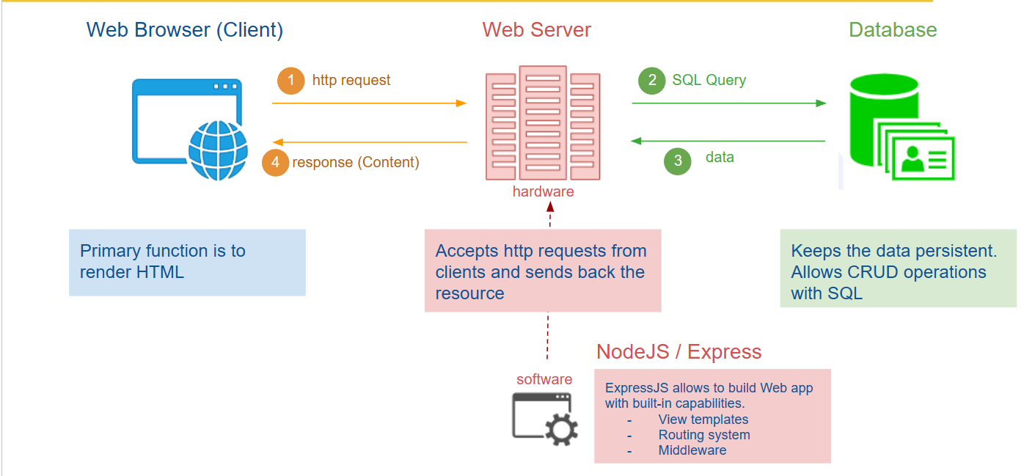
3 Tier Architecture
Notes:
The 3-Tier architecture is a software design pattern that separates an application into three logical layers: presentation, business logic, and data storage. The presentation layer handles user interactions, the business logic layer processes and manipulates data, and the data storage layer manages data persistence.
n-Tier architecture is an extension of the 3-Tier architecture that allows for greater scalability and flexibility by introducing additional layers and components. It separates the application into multiple layers, such as presentation, business logic, data access, and more, depending on the specific needs of the system.

Slide 6
CRUD
It could also be bread
Notes:
What are callbacks? Anyone remember what these are?

Slide 7
CRUD
CRUD stands for Create, Read, Update, and Delete. It represents the basic operations that can be performed on persistent data:
Create: Creating or adding new data or resources.
Read: Retrieving or reading existing data or resources.
Update: Modifying or updating existing data or resources.
Delete: Removing or deleting existing data or resources.
CRUD operations are commonly used in database systems and web applications to handle data manipulation.
Notes:
Routing System: In Express.js, the routing system refers to the mechanism that allows you to define and handle different HTTP requests made to your web application. It helps in mapping URLs to specific functions or handlers, enabling you to create a logical structure for handling different routes and their associated actions.
Templating Engine (ejs): EJS (Embedded JavaScript) is a popular templating engine used in Express.js. It allows you to generate dynamic HTML content by embedding JavaScript code within your HTML templates. EJS provides a convenient way to generate HTML pages with dynamic data, such as variables and conditional statements, making it easier to build dynamic web applications.
Middleware Functions: Middleware functions in Express.js are functions that have access to the request and response objects and can perform specific tasks during the request-response lifecycle. These functions are executed in a sequential order, and they can modify the request or response objects, invoke the next middleware function in the stack, or terminate the request-response cycle. Middleware functions are often used for tasks such as authentication, logging, error handling, and processing of request data before reaching the route handlers.

Slide 8
HTTP VERBS
HTTP ACTIONS?
Notes:
What are callbacks? Anyone remember what these are?

Slide 9
VERBS
Verb | Description | CRUD / BREAD
POST | Used to submit data to the server to create a new resource. It is non-idempotent since repeated requests may result in multiple resource creations. | Create / Add
GET | Used to retrieve or fetch a resource from the server. It is a safe and idempotent operation, meaning it should not modify any data on the server. | Read / (Browse & Read)
PUT | Used to update or replace an existing resource on the server. It is idempotent, meaning repeated requests will have the same result. | Update / Edit
DELETE | Used to delete a resource on the server. It is idempotent, meaning repeated requests will have the same effect. | Delete / Delete
Other verbs: PATCH, HEAD, OPTIONS, TRACE
Notes:
GET: Used to retrieve or fetch a resource from the server. It is a safe and idempotent operation, meaning it should not modify any data on the server.
POST: Used to submit data to the server to create a new resource. It is non-idempotent since repeated requests may result in multiple resource creations.
PUT: Used to update or replace an existing resource on the server. It is idempotent, meaning repeated requests will have the same result.
PATCH: Similar to PUT, but used to perform a partial update on an existing resource. It allows modifying specific fields without replacing the entire resource.
DELETE: Used to delete a resource on the server. It is idempotent, meaning repeated requests will have the same effect.
HEAD: Similar to GET, but it retrieves only the headers of a resource without the actual content. It is often used for checking resource metadata or obtaining information about caching.
OPTIONS: Retrieves the communication options available for a resource or the server. It helps to determine which HTTP methods are allowed on a particular resource.
TRACE: Echoes the received request back to the client. It is primarily used for diagnostic or troubleshooting purposes.

Slide 10
Express JS
Now it becomes fun…
Notes:
What are callbacks? Anyone remember what these are?

Slide 11
Express JS
Tooling that Express JS Provides:
Routing System
Template Engine (EJS)
Middleware Functions
Notes:
Routing System: In Express.js, the routing system refers to the mechanism that allows you to define and handle different HTTP requests made to your web application. It helps in mapping URLs to specific functions or handlers, enabling you to create a logical structure for handling different routes and their associated actions.
Templating Engine (ejs): EJS (Embedded JavaScript) is a popular templating engine used in Express.js. It allows you to generate dynamic HTML content by embedding JavaScript code within your HTML templates. EJS provides a convenient way to generate HTML pages with dynamic data, such as variables and conditional statements, making it easier to build dynamic web applications.
Middleware Functions: Middleware functions in Express.js are functions that have access to the request and response objects and can perform specific tasks during the request-response lifecycle. These functions are executed in a sequential order, and they can modify the request or response objects, invoke the next middleware function in the stack, or terminate the request-response cycle. Middleware functions are often used for tasks such as authentication, logging, error handling, and processing of request data before reaching the route handlers.

Slide 12
Express JS
Some common Terms
Tags - <% %> and <%= %> The <% is an EJS Scriplet
Templates - refers to the individual files within the views directory that contain the HTML structure combined with embedded logic.
Views - refers to the directory where template files are stored.
Partial View - a modular and reusable component that can be included within other views to enhance code reusability and reduce redundancy.
Variable - a placeholder that holds a value, allowing dynamic content to be injected into an EJS template during rendering.

Slide 13
Before we get into the thick of it:
app.get('/', (req, res) => {
// Handle logic for the root path
res.send('Hello, LHL student!');
});
app.post(‘/books/create', (req, res) => {
// Handle creating a book logic
// Access request body using req.body
});
Notes:
app.get(path, callback):
This function sets up a route to handle HTTP GET requests for a specific path or URL. The callback function specifies the logic to be executed when that route is accessed via a GET request.
app.post(path, callback):
This function sets up a route to handle HTTP POST requests for a specific path. Similar to app.get(), the callback function defines the logic to be executed when the specified route is accessed via a POST request.

Slide 14
Routes
Route Ordering matters!
Consider the Following:
app.get('/users', function(req, res) {
// Handle general user request
});
app.get('/users/:id', function(req, res) {
// Handle specific user request
});
Notes:
In Express.js, the order in which routes are defined can be significant because the routes are evaluated in the order they are defined. When a request comes in, Express.js will start at the top of your route definitions and continue down until it finds a matching route. Therefore, it is generally a good practice to define more specific routes before more general ones. This is because if a more general route is defined before a specific one, the general route will match the request before the specific route has a chance to be evaluated.
In this case, if the route for /users is defined before the route for /users/:id, the general route will be matched for requests like /users/123, and the specific route will never be reached. However, if the specific route is defined first, it will be matched for requests with a parameter, such as /users/123, and the general route will only be matched for requests to /users without any parameters.
So, while there is no strict rule enforced by Express.js about the order of routes, it is advisable to organize your route definitions from more specific to more general to ensure the desired behavior for your application.

Slide 15
DEMO TIME

